Slide 1
Artificial Intelligence (AI)– May 30
Agenda
Mod C.5 Artificial Intelligence
Level 1 – Eliza (Today)
Level 2 – Turing Test (Today)
Level 3 – Journalism (Tuesday)
Laval 4 – TBD (Wednesday)
Upcoming
Tomorrow : About Alan Turing
The father of Computing

Slide 2
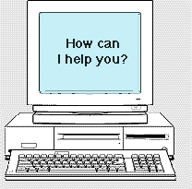
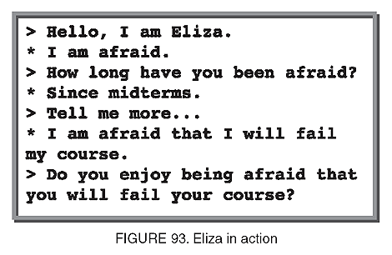
Eliza (1966)
First example of a Natural Language AI
Simulates a On-Line Therapy Session
Proved that a computer had the potential to fool people
URL
http://psych.fullerton.edu/mbirnbaum/psych101/Eliza.htm

Slide 3
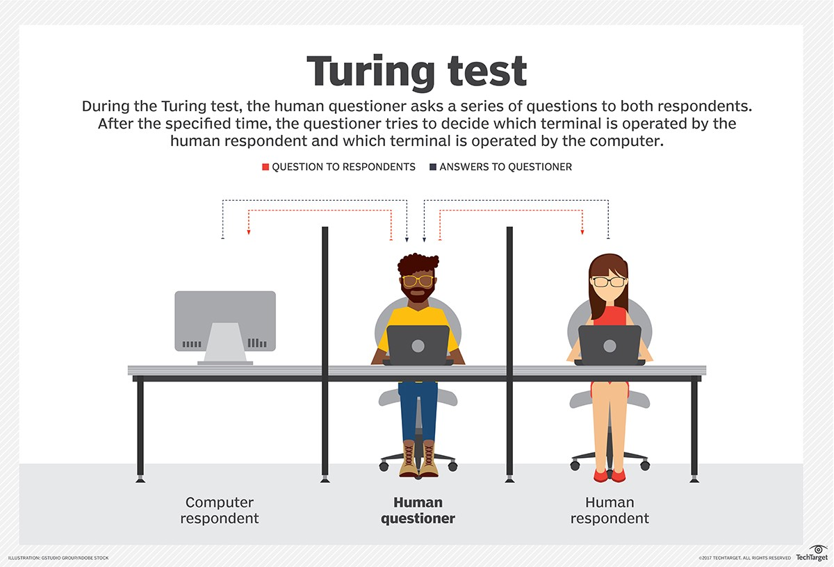
Turing Test (1950)
Developed by Alan Turing (more about him later)
A theoretical test / standard for what would be considered Intelligent
Video
https://ed.ted.com/lessons/the-turing-test-can-a-computer-pass-for-a-human-alex-gendler

